Slide 1
Neuralink’s Brain-Computer Interface (BCI): Revolutionizing Technology and Raising Ethical Questions
Maria Haddon CSCI-344
Notes:
-Neuralink is a brain technology company
-”Mind-meld” with computers
-Fascinating fusion of cutting- edge science and controversy
-Could have the potential to help people with disabilities interact with technology
Controversial
-Complicated surgical procedures
-Animal testing
-Privacy
-Inability to disconnect

Slide 2
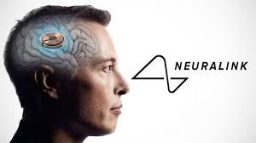
Neuralink is a brain technology company founded by Elon Musk.
Aims to create brain-computer interfaces (BCIs) that allow people with disabilities to control digital devices.
In August 2024, a patient named Alex used a Neuralink implant to play Counter-Strike 2 using only his brain​ (VICE, euronews)
Key Points
Notes:
Small device about the size of a quarter with 60 electrodes that are thinner than a strand of hair
Neuralink reads brain signals and translates them into digital commands
Alex would be able to aim with his thoughts and use a mouth joystick allows him to move the character

Slide 3
Technical Challenges and Ethical Concerns
Earlier trials faced issues, such as electrodes becoming detached in the first patient​ (VICE, euronews)
Alex’s implant has shown improvements with more stability.
Ethical Concerns:
Co-founder Benjamin Rapoport left due to safety concerns regarding the surgical procedures​ (Decrypt).
Animal testing controversy: Over 1,500 animals reportedly died during development​( Decrypt).

Slide 4

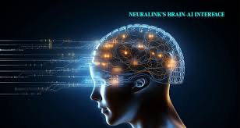
The Road Ahead
Neuralink is developing full digital control, aiming for video game and robotic functionality​
Long-term concerns include privacy and ethical implications of brain-computer integration.
Neuralink has shown incredible potential, but challenges regarding safety and ethics must be addressed​
Notes:
-Full digital control for video game and robotic functionability
-Limb loss, spinal cord injury controlling computers
-Using Neuralink to drive a Tesla
Oversight and regulation will be crucial to ensure that the technology is deployed ethically and responsibly
-FTC, FDA, National Institutes of Standards and Technology (NIST), Human Rights Organizations, SEC (investors)

